Slide 1
Team 4:
Ashley
Kris
Ryan

Slide 2

Requirements

Slide 3
Requirements
What did you learn writing your requirements?
What were the difficulties you encountered?
What could you have done to improve this process?
How could you have made your requirements more complete, concise, consistent and clear?
Notes:
What did you learn writing your requirements?
When my team and I first started our requirements. We discussed an overview of what the game would consist of. Made sure the requirements would be met. And At the end of our first meeting, we split the rooms equally. Each person took a floor of the game map and created whatever came to mind.
We all began to do that, and by the time of our next meeting. We all had a clear idea what we wanted to happen in each floor and then found a way to combine the other floors together.
While writing out the requirements, I learned that fresh eyes should be a must. Letting others read the document and give you their thoughts on it. Things you might have missed or did not even think a about.
Another, the flow of the game should be complete, concise, consistent, and clear to the reader.
1. Complete - the requirements did not include everything. There are parts of the description of the game that were missing.
2. Concise - The descriptions of the requirements did not convey the ideas properly.
3. Consistent - There were parts do not connect with the rest of the document.
4. Clear - the format was all over the place. not every detail was said properly or clearly.
What were the difficulties you encountered?
Difficulties that my team and I encountered were:
1. Assuming the requirements were complete, concise, consistent, and clear. We believed that it would be understandable to the reader. Besides Dr. Price feedback, other people should have read it and it could have made our document a lot better.
2. No redundancies. Explain each requirement only once and a way to refer to that requirement if needed.
3. It was a bit difficult to make sure nothing was left out and everything was clear to the reader.
4. After written all the requirements, it was a bit difficult to trace out the game. The flow of the game was not concise.
What could you have done to improve this process?
Things we could have improved this process is by:
1. Discussing the requirements further into detail. Even though my team was dynamic. Just made sure all the main parts were there.
2. Discussing the format of the document would have been helpful so it can be consistent and helpful to the reader. The reader can have a clear idea on how to read the document.
3. Giving feedback to each of the team members so that they can review their part of the requirements and adjust if needed.
Another is to
4. Expanding the ideas on the requirements. Make sure that it is to the point.
5. Try to make sense of it all instead of just putting our ideas into paper. Go over the requirements and see if it realistic to make, can it be tested? and traceable?
How could you have made your requirements more complete, concise, consistent, and clear?
To make the requirements is more complete, concise, consistent, and clear would be to go through the whole document not once but a few times until
1. Complete – all the descriptions of the requirements are not missing. Meaning each detail of the game is explained. The game will be traceable and deal with exceptions properly.
2. Concise –Convey the ideas appropriately. Be brief and to the point. Do not leave the reader questioning what you meant or confused of the structure of the game. Do not assume the reader knows it all.
3. Consistent - Make sure there are not conflicts in the requirements. The requirements should connect with the game flow from start to finish.
4. Clear – Have a clear understanding of the format of the document. Make sure it is readable and clear where each part of the requirements is located.

Slide 4
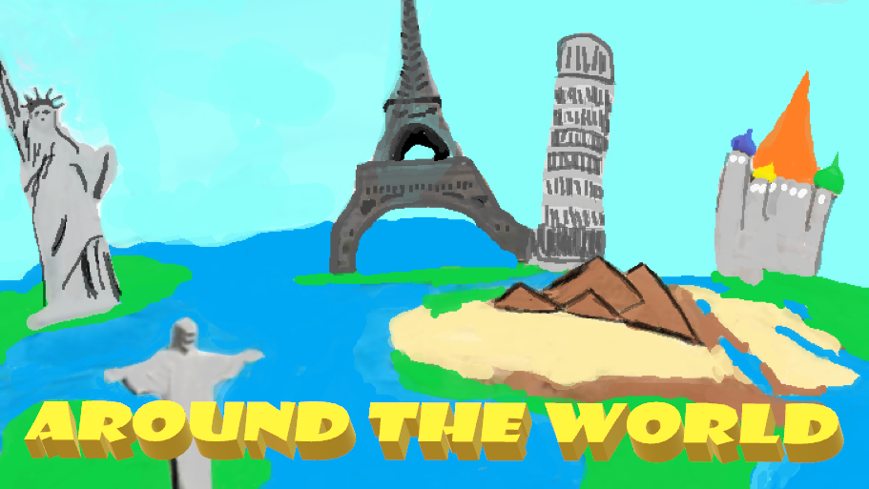
Team 4:
Ashley
Kris
Ryan

Slide 5
Around the World
The Game
The Player
The Rooms
The Monsters
The Puzzles
Player Inventory
Score System
Notes:
The Game
Around the world is an interactive computer game, in which the user explores interconnected rooms, collecting certain weapons and potions to be able to fight and defeat their corresponding monster, as well as puzzles that the user must solve to be able to move from room to room and all of this is possible through the user inputting the corresponding input into the system. The user can move rooms, solve puzzles, collect weapons and potions, save, and load current progress.
The Player
The player will be able to move around from room to room with user input. The player will be able to pick up and remove items with a max capacity of 3 items. The player will be able to input answers to puzzles and items to be able to defeat monsters. User will have health that starts at 100 and will go down with each incorrect answer from the puzzle and monsters.
The Rooms
A room will allow player to enter and to leave and will be connected with other rooms, so one room will connect with another room. In these rooms, there will be monsters or puzzles and on some there can be items to be picked up.
The Monsters
Monster will be in rooms, and if the player decides to fight the monster, the player will input an item that will defeat the monster, if incorrect, them the monster will attack and remove health from the player. Player will be asked to input an item until monster is defeated or until player runs away. There is only one item that can defeat each corresponding monster.
The Puzzles
A puzzle will be in some rooms, and when a player enters the room, they will encounter the puzzle and the player objective is to compete the puzzle to be able to advance to the next room. They can input TIP, to let the system display the TIP, and there is only one tip per puzzle. Each time player gets the puzzle wrong, they loose health.
Player Inventory
The player has an inventory, in which it can hold on to only 3 items which can be found in some rooms. If they have 3 items, system will allow them to exchange for an item they have, so they get the new item and the old item is removed and dropped in that room.
Score System
Player has a score that increases through the rooms. For each puzzle and monster that is passed, player will increase their score by 10 points, so if one puzzle and one monster is passed score will be increase by 20. Since to finish the game all monsters and puzzles must be cleared, the health of the player also affects the score in the end. So, if the player has only 80 health remaining, then that 80 health is multiplied by the score that they got and that is the final score.

Slide 6
Analysis

Slide 7
Analysis
What did your analysis reveal about the requirements you were given?
How did it help your efforts on the project?
What could you have improved?
What were the things that you discovered that helped, what were the things you missed?
Notes:
What did your analysis reveal about the requirements you were given?
During the Analysis phase we felt comfortable with the requirements we were given. The game was straight forward, and the requirements had a lot of detail that we were able to use to construct class and object diagrams and create a dynamic model of the system. As a result, we were sure that we could easily create the game that we were given as described in the requirements document.
How did it help your efforts on the project?
The requirements were the roadmap that led to everything else. There wasn’t a phase in the development process that we didn’t have to refer back to the requirements to check that what we were doing was what the client wanted.
What could you have improved?
We learned how important it is to refer to all available references and how important details are even when performing a high-level analysis. We didn’t discuss the interactions between the database and how game functions like new game or load game would communicate with it. Or how the game would pull information from the database during play. We also needed to be clearer with our analysis. A lot of our explanations were closer to technical speak and not in terms that a client would understand.
What were the things that you discovered that helped, what were the things you missed?
We found out quickly during the design process that we missed a couple key things:
End game: while the requirements described the end of the game, there was no mechanism to reach the end
Save game: Whereas the requirements only required that one save game be allowed, the project requirements stated multiple users should be able to save so we should have caught that conflict in analysis.
Player ID : We didn’t discuss how each player profile would be saved until we were in implementation. This is definitely something that should have come up earlier.

Slide 8
Design

Slide 9
System and Object Design
How closely did your implemented system follow your design?
Did your design expose any shortcomings in the requirements?
Notes:
How closely did your implemented system follow your design?
The implemented system we ended up with was similar to the design we created. The classes and methods we created remained intact, but we had to add several methods to handle interactions we hadn’t clearly thought through like with monsters and puzzles. Also while we had a good design for the database we didn’t detail the classes for the database. Overall the object design just wasn’t detailed enough and had we been more detailed when implementation came around, coding the game would have been smoother.
Did your design expose any shortcomings in the requirements?
We did miss some details in our object design that we had to make up for during implementation.
1) We knew we needed a database, but didn’t show detailed interactions between the database or how it would sit with the model. This caused us to have to come up with solutions on the fly and created unnecessary problems.
2) The save and load requirement that we did in analysis, were not really detailed enough in the design phase so we were dealing with that more in implementation and caused us to do more on the fly.
3) There were issues that were present with the details of the rooms, puzzles and monsters that were also missed in design and we discovered during implementation. They weren’t catastrophic, but simple things like the rooms descriptions didn’t match up to the directions on the map in some places, there was a monster that appeared in two different rooms and another that was left unused, and also a puzzle out of place. Had we been more detailed in design we would have caught these things earlier.
Had our design included the amount of detail we should have put into it, we likely could have coded the entire game within a day.

Slide 10
Database Design
What tables did you use?
Rooms
Monsters
Puzzles
Items
Players
What changes did you have to make as you progressed through the project?
Notes:
What tables did you use?
Rooms – the rooms table contains entries denoting the specifics of all the rooms used in the map
Monsters – the monsters table contains entries denoting the specifics of all the monsters to be included in the game
Puzzles - The puzzles table contains entries denoting the specifics of all the puzzles to be included in the game
Items – The items table contains entries denoting the specifics of all the items in the game
Players – the players table contains entries denoting all of the players, their inventories, and specific player profile information including the score
What changes did you have to make as you progressed through the project?

Slide 11
Implementation

Slide 12
Implementation
What pitfalls did you encounter?
What requirement changes did you need to make from your discoveries during implementation?
What were the major challenges to implementation?
What solutions did you come up with?
Notes:
What pitfalls did you encounter?
When working with the puzzles and monsters it was quickly realized that the user should be allowed to input more into the console than just simple commands. We had to insert a check that determined if either was present in the room that would then send the input into another set of methods to handle the answers or items being passed through. There was a similar problem with the monster interactions because the user would need to enter information other than simple commands. We also had to disable commands like move to keep the user from bypassing the obstacles in their way.
We hadn’t fully realized the score system and it was one of the last features we implemented.
What requirement changes did you need to make from your discoveries during implementation?
Most things stayed the same, but we did have a few things:
1) The wording was altered to make the game flow better. The room descriptions included the mention of items and monsters, but once you defeated them, we needed to remove them from the room.
2) Some available exits in the room descriptions were different than the exits listed on the map, so we changed the descriptions to match the map.
3) There was a monster used twice and another monster not used at all, so we swapped a monster in one room.
4) There was a puzzle missing from the room descriptions, so we inserted it to a room we felt fit the flow of the game.
What were the major challenges to implementation?
The most challenging thing during implementation was staying on the same page. With all the moving parts and the three of us working together there was plenty of opportunity for things like merge conflicts and things of that sort.
What solutions did you come up with?
I think we handled it really well, but it required constant interaction via discord. We were leaving messages all hours of the day and in and out of voice channels daily. The team did a great job of maintaining an open line of communication with each other and responding quickly to questions. I think that the strong communication we had as a team and the way we easily came together was a great help for the entirety of the project, not just implementation. Our greatest challenge was also a huge asset.

Slide 13
Demo

Slide 14


Questions?

